Slide 1
December Meeting
Team Meeting & 700 Governors Drive
12-18-2024 10:00 AM

Slide 2
Agenda
10:00 AM Call Meeting to Order-
Roll Call of Members- Secretary
Additional Items to be added to agenda –
Approve meeting minutes of September meeting
Organizations
Police Chiefs Assn. – Jason Jones
Sheriff’s Assn – Steve Swenson
DCI/Attorney General – Chad Mosteller
GFP – Bruce Nachtigall
DOT – Brian Wacholz
National Guard – David Goodwin
Emergency Managers – Pat Harrington
Firefighters – Charlie Kludt
Healthcare – Tim Rave
Highway Patrol – Micheal Peterson
APCO/NENA – Kevin Karley
EMT – Brent Long
Wildland Fire – Ray Black
County Commissioners – Kade Haley
Health Department – Chuck Kevghas
Tribal Governments – Jim Pearson
Federal Government – Andy Barth
BIT Engineering – Trent Nincehelser
SD Senate – Vacant
SD House of Representatives – David Kull
911 – Jason Husby

Slide 3
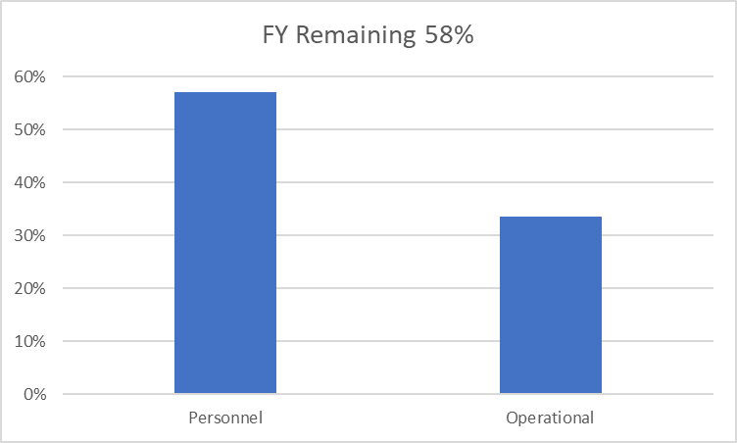
Old Business
Budget
Nearly 22% of total operational budget is paid in July for annual Motorola support contract
57.6% Personnel and 34% of Operational funds available

Slide 4
Old Business (Continued)
2. Broadband Subcommittee Report
FirstNet Buildout Updates
Critical Connect/ePTT services now live
T-Mobile updates
3. Meade County I90 Corridor update
$46,000 funding appropriated for radio coverage study
Kicked off project in October
Surveys sent out to stakeholders in effort to gather data and feedback regarding radio operations in Meade County
RFCC planning to hold town hall meetings for input
RFCC to give written status report for legislature in January
Determine next steps pending study results
4. Minnehaha County Project updates
North Minnehaha Simulcast anticipated completion Q1 2025
Mission Critical Partners recently completed radio study for Sioux Falls
Working closely with Sioux Falls to tackle challenges
Remote Radio Management planning/implementation

Slide 5
Old Business (Continued)
5.Drone Tower Inspections
Total of 5 drones donated from SDHP
First State Radio technician became FAA part 107 licensed in November
Continue to get others FAA Part 107 licenses
6. Organization Representative Vacancies
SD Senate
Working with Govs office on pending appointments

Slide 6
New Business
1. SWIC Updates – Todd Dravland (SWIC South Dakota)
2. State Radio APX programming Classes
First Class Scheduled for February 3-6, 2025
$750 per student
Working with City of Sioux Falls to schedule classes for APX,MCC7500, and UPM
3. PSAP Consolidation Surveys – Jason Husby
4. Inter-RF Subsystem Interface (ISSI) for cross-border Communications – Kendall Light
Currently working with state of Wyoming, Montana, and Nebraska

Slide 7
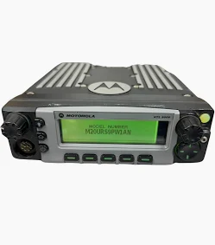
New Business (continued)
5. Sturgis Site Channel additions
Adding two channels
FCC Licensing Completed
Plan for Q1 2025 completion
6. Donated Wyoming Radios
XTL 5000 50-Watt Mobile Radios
Coordinated, programmed, and installed nearly 200 radios for GFP and DOT since spring
Worked with Oglala Sioux Tribe EM office to pickup, program, and distribute 115 radios for OST and RST
Agencies purchase wiring harnesses/install hardware
Other Agency needs?
More radios may be available

Slide 8
Organizational Reports
Organization Reports
Police Chiefs Assn. – Jason Jones
Sheriff’s Assn – Steve Swenson
DCI/Attorney General – Chad Mosteller
GFP – Bruce Nachtigall
DOT – Brian Wacholz
National Guard – David Goodwin
Emergency Managers – Pat Harrington
Firefighters – Charlie Kludt
Healthcare – Tim Rave
Highway Patrol – Micheal Peterson
APCO/NENA – Kevin Karley
EMT – Brent Long
Wildland Fire – Ray Black
County Commissioners – Kade Haley
Health Department – Chuck Kevghas
Tribal Governments – Jim Pearson
Federal Government – Andy Barth
BIT Engineering – Trent Nincehelser
SD Senate – Vacant
SD House of Representatives – David Kull
911 – Jason Husby
Closing Comments
Vice-chair –
Member at Large - Kevin Karley
Chair – Bruce Nachtigall
Next Meeting: date, time, location – tentative March 12th

